Slide 1
Weather predicting with data science approaches
U-yong Shim, Min-Geun Song

Slide 2
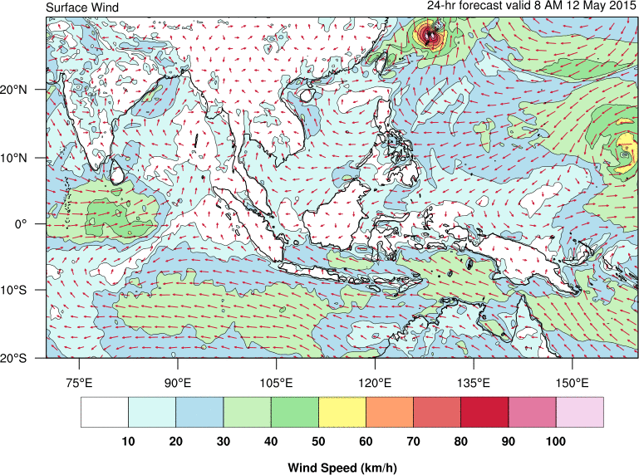
Weather predicting
Weather predicting is the application of science and technology to predict the conditions of the atmosphere for a given location and time.
Weather predicting is made by collecting quantitative data about the current state of the atmosphere at a given place and using meteorology to project how the atmosphere will change.

Slide 3
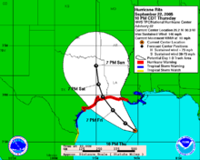
In data science..
In general, weather predicting is about the data about the atmosphere
Data science is very important in weather forecasting.

Slide 4
In data science..
Exploratory data analysis(Example)
use data from one meteorology station
wants to get predicted precipitation data
29 variables and 22 064 records
T — Air temperature (degrees Celsius)
Po — Atmospheric pressure at weather station level
P — Atmospheric pressure reduced to mean sea level
….
Source
https://towardsdatascience.com/weather-forecasting-with-data-science-approaches-cb8f2afd3f38

Slide 5
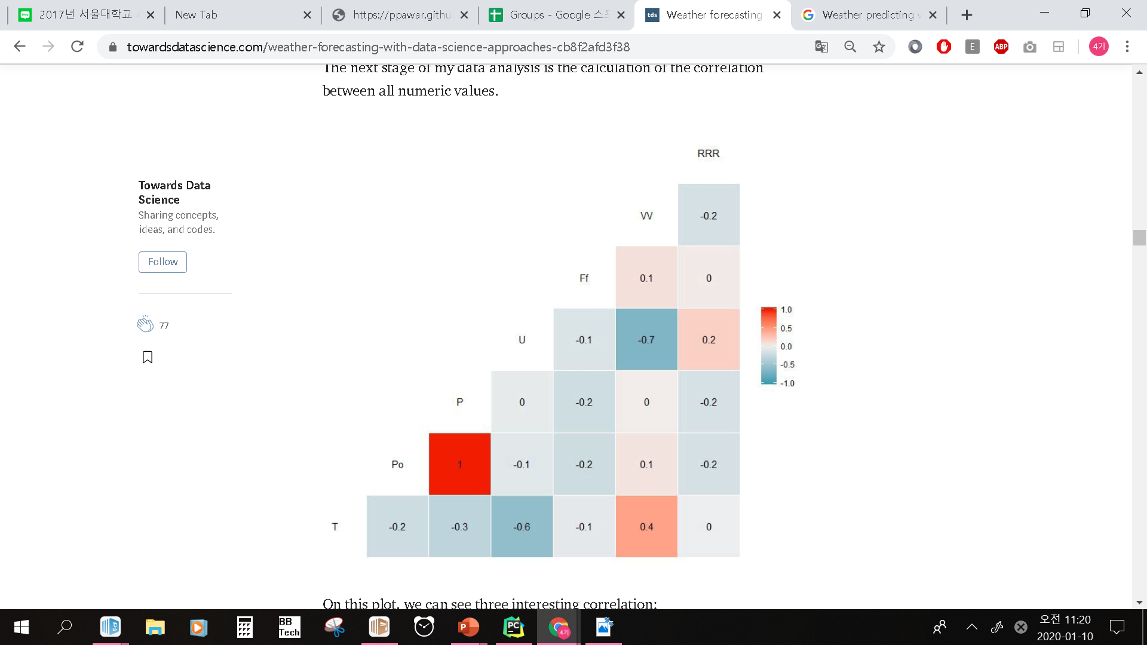
In data science..
This matrix shows the correlation between some numeric values.
Each numerical value means the correlation coefficient (c)
If c>0 positive correlation
If c<0 negative correlation
Source
https://towardsdatascience.com/weather-forecasting-with-data-science-approaches-cb8f2afd3f38

Slide 6
In data science..
Following are the significant results in matrix
The positive correlation (0.4) between Temperature and Horizontal visibility
The negative correlation (-0.6) between Temperature and Relative humidity
The negative correlation (-0.7) between Relative humidity and Horizontal visibility.
Source
https://towardsdatascience.com/weather-forecasting-with-data-science-approaches-cb8f2afd3f38

Slide 7
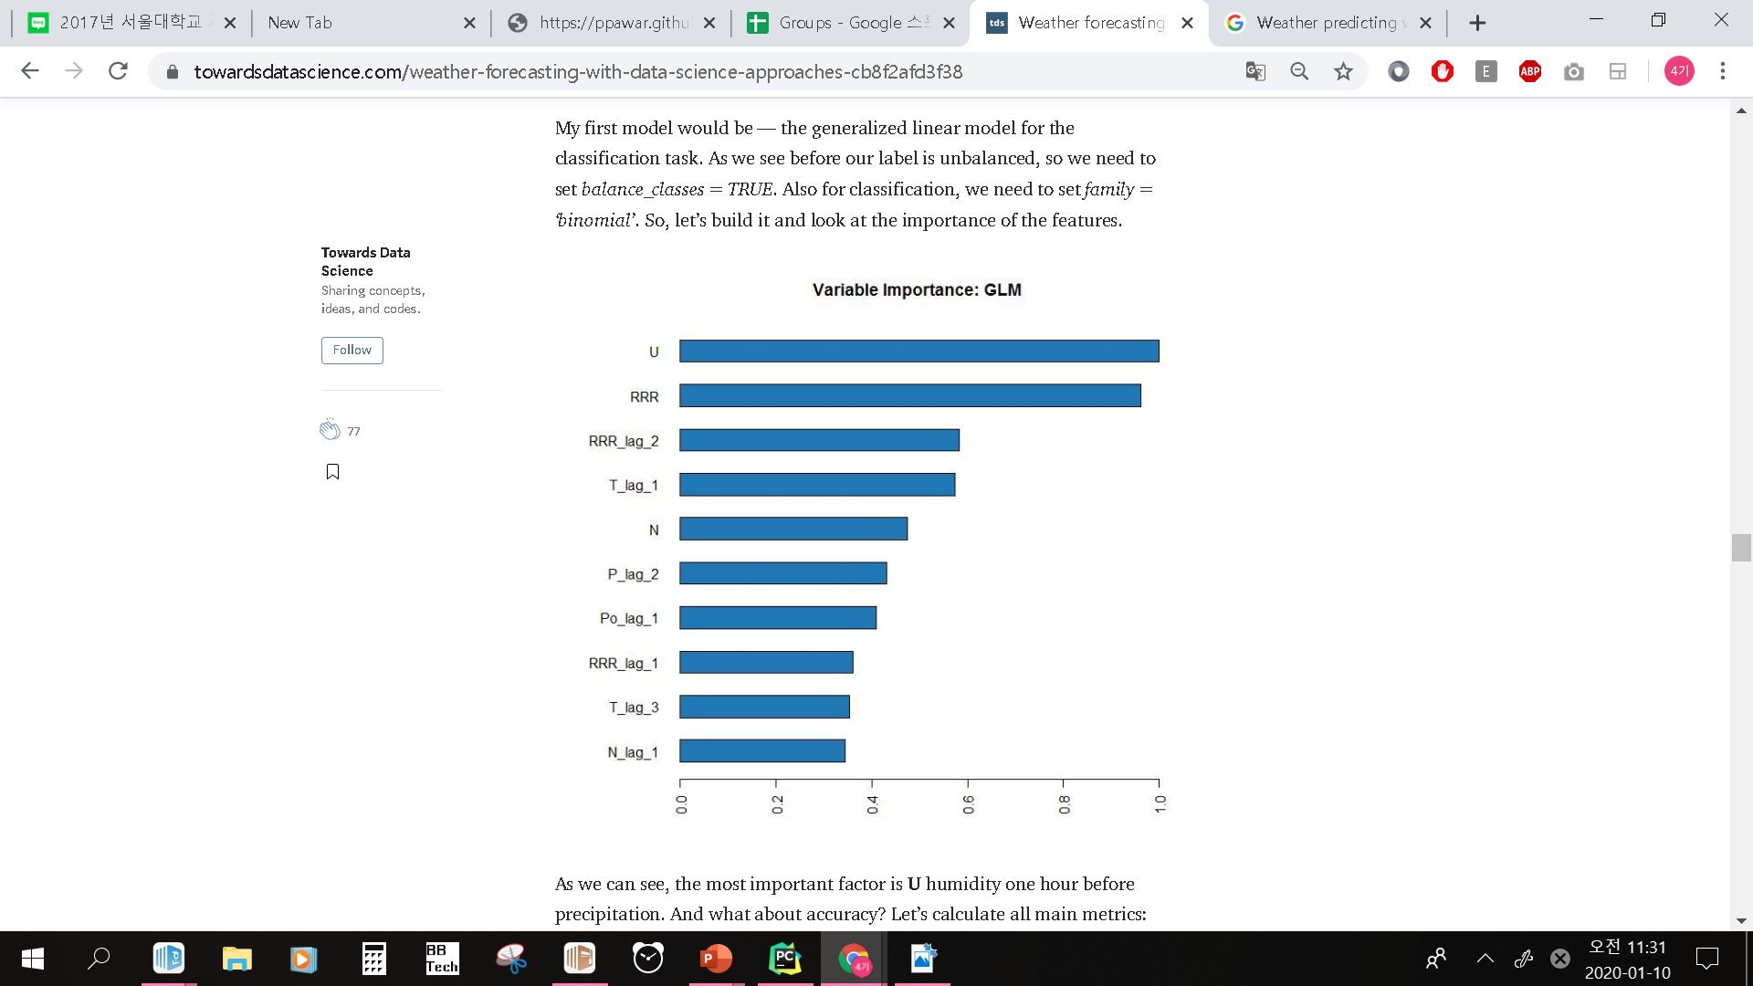
In data science..
Modeling
generalized linear model
Calculate variable correlation
Use deep learning
can predict precipitation only in 56%.
Source
https://towardsdatascience.com/weather-forecasting-with-data-science-approaches-cb8f2afd3f38

Slide 8
In data science..
Modeling
regression model
Additionally look for signals in the up-and-down history of the past movements
high accuracy than generalized linear model
Source
https://towardsdatascience.com/weather-forecasting-with-data-science-approaches-cb8f2afd3f38

Slide 9
Conclusion
Data science can help in weather prediction.
Environment variable analysis and the machine learning algorithms can help in prediction for a short term period.
To get good results, we need to use RNN architecture in the neural networks.

